Slide 1
Marketing materials to restuarants
Applied Data Science Capstone
IBM Data Science Professional Certificate

Slide 2
Synopsis
Part 1: Problem Description
An investor is planning to invest in a marketing concern of vegitables, friuts, drinks and other materials. He is about to study the most suitable location to start in boroughs of Toronto (Scarborough) to find the most profitable location. By finding it he will be able to provide necessary materials in that place more efficiently to the restaurants.

Slide 3
Synopsis
Part 2: Data We Need
First and foremost, the data needed is about the areas by foursquare API, and then the data about restaurants in that particular area which can be collected online

Slide 4
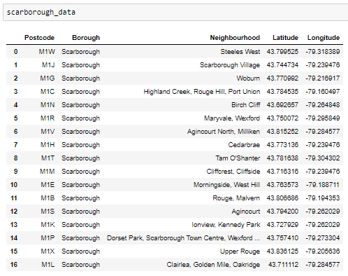
Main Article
Part 1: Identifying Postal Codes (and then Neighborhoods) in "Scarborough"

Slide 5
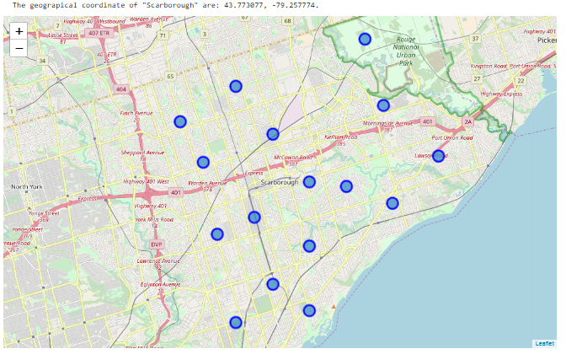
Main Article
Part 1: Identifying Postal Codes (and then Neighborhoods) in "Scarborough"

Slide 6
Main Article
Part 2: Connecting to Foursquare and Retrieving Locational Data for Each Venue in Every Neighborhood
After finding the list of neighborhoods, we then connect to the Foursquare API to gather information about venues inside each and every neighborhood. For each neighborhood, we have chosen the radius to be 1000 meter. It means that we have asked Foursquare to find venues that are at most 1000 meter far from the center of the neighborhood.

Slide 7
Main Article
Part 3: Processing the Retrieved Data and Creating a DataFrome for All the Venues inside the Scarborough
When the data is completely gathered, we will perform processing on that raw data to find our desirable features for each venue. Our main feature is the category of that venue. After this stage, the column "Venue's Category" wil be One-hot encoded and different venues will have different feature-columns. After On-hot encoding we will integrate all restaurant columns to one column "Total Restaurants" and all food joint columns to "Total Joints" column.

Slide 8
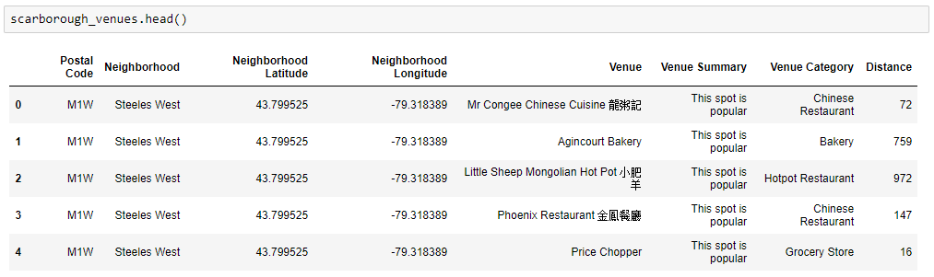
Main Article
Part 3: Processing the Retrieved Data and Creating a DataFrome for All the Venues inside the Scarborough

Slide 9
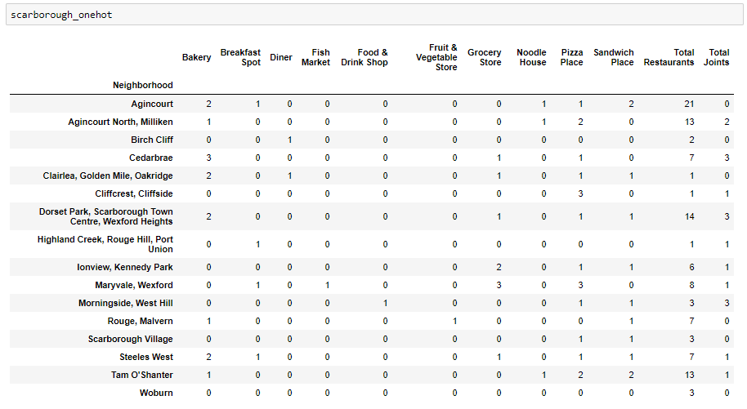
Now, the dataset is fully ready to be used for machine learning (and statistical analysis) purposes.

Slide 10
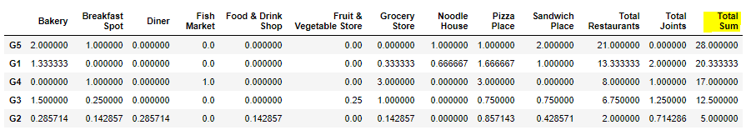
Main Article
Part 4: Applying one of Machine Learning Techniques (K-Means Clustering)

Slide 11
Decision Making and Reporting Results
Now, we focus on the centers of clusters and compare them for their "Total Restaurants" and their "Total Joints". The group which its center has the highest "Total Sum" will be our best recommendation to the contractor. {Note: Total Sum = Total Restaurants + Total Joints.} This algorithm although is pretty straightforward yet is strongly powerful.

Slide 12
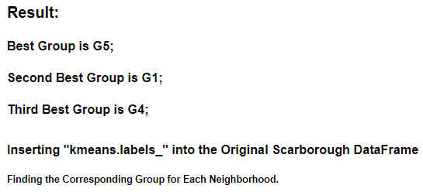
Decision Making and Reporting Results

